Slide 1

PROJECT
GESTURE BASED CRYPTOGRAPHY IN VIDEO GAMES
BY EMERIT Beemul
Notes:
My Name is Emerit Beemul and this is my teammate Thenaven Velloupillay. I will be presenting our project that revolves around Gesture Based Cryptography in video games. In our case, I chose to implement the algorithm on a basic 2D snake game which I'm sure many of you have played before.

Slide 2

What is Gesture Based Cryptography
Gesture based cryptography in general would be using hand gestures/movement or facial recognition in the game environment to differentiate a player from another player.
For this project, I focused mainly on the hand gesture part.
Why did I choose this?
Had my save game data deleted a couple of times by people who logged in to my profile.
Instead of using passwords or codes which can be forgotten by a player, specific gestures are assigned to each profile which can make this easier to authenticate a user.

Slide 3
Research
Key Terms:
Authentication: For this project, authentication involves confirming the identity of a player through the recognition of predefined gestures.
In the context of this project, cryptography is used to enhance the security of the snake game by incorporating a form of user authentication based on hand gestures. This doesn't involve traditional cryptographic techniques like encryption or decryption. Instead, it uses the uniqueness of hand gestures as a form of authentication.
After doing some research, I noticed that there are multiple games that use gesture control but there are very few games that use Gesture authentication. I decided to then try and create our own code to see if this was even possible as now the topic became more interesting after learning that very few games use this feature.
A Common example of a game that uses gesture controls would be Just Dance.
Had to do some research on Cvzone and mediapipe modules. Cv zone has a ‘HandDetector” class that could be helpful in this project.

Slide 4

How did I implement the Gesture-based Authentication?
Multiple functions were used and I had to create the snake game from scratch. But the main functions used to implement the authentication part are:
The HandDetector class from the cvzone library is used for hand tracking and gesture recognition.
The input_gesture() function records a user's gesture for authentication. The gesture is recorded as a dataset following the image to the right. The finger positions are then stored as a series of binary values, representing whether each finger is up or down.
This is stored in a list and then this list is then compared with a new list when the user tries to load a saved game.
The gestureCheck() function records a second gesture for verification.
The compare_Input() function compares the two recorded gestures for authentication
Tools needed:
The Snake_game_gesture_crypt_final program which has the code for the gesture detection algorithm and a small snake game created for the purpose of having multiple players and different save datas.
A PC/Laptop that has a webcam

Slide 5
Process
Gesture Recording:
The input_gesture() function initiates the camera, capturing hand movements for a specified duration (5 seconds).
It uses the HandDetector class to find hands in the camera feed and retrieve finger positions. (up or down)
The finger positions are then stored as a series of binary values, representing whether each finger is up or down.
The resulting data, representing the recorded gesture, is returned.

Slide 6
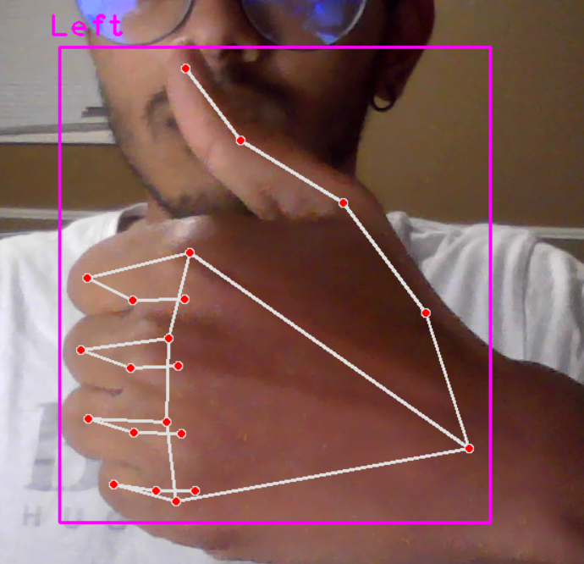
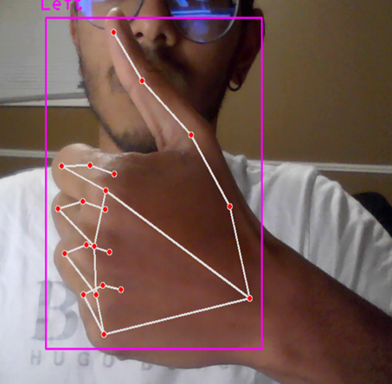
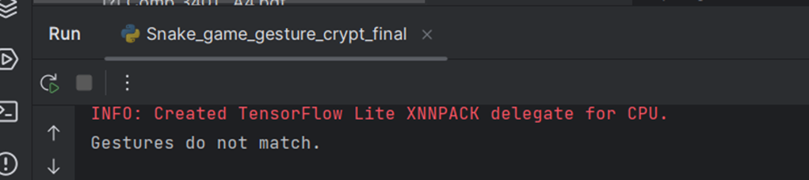
Testing
During the testing period of this whole algorithm, I had a few runs, where false negatives have occurred when I tried the same Gestures for identification. False positives also occurred when I made different gestures or if I moved my hand a lot during the 4-5 seconds timeframe where the program records the gestures.
The first picture below is the predetermined gesture that I used to authenticate my profile. The second picture is the same gesture that I used and that generated a false negative.

Slide 7
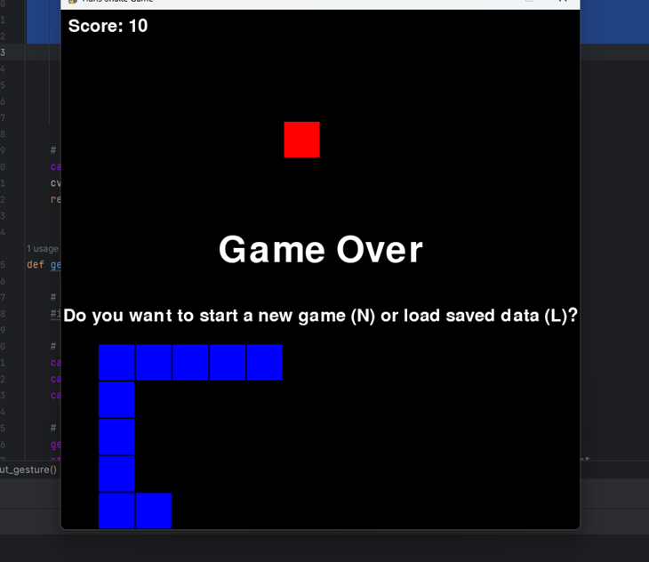
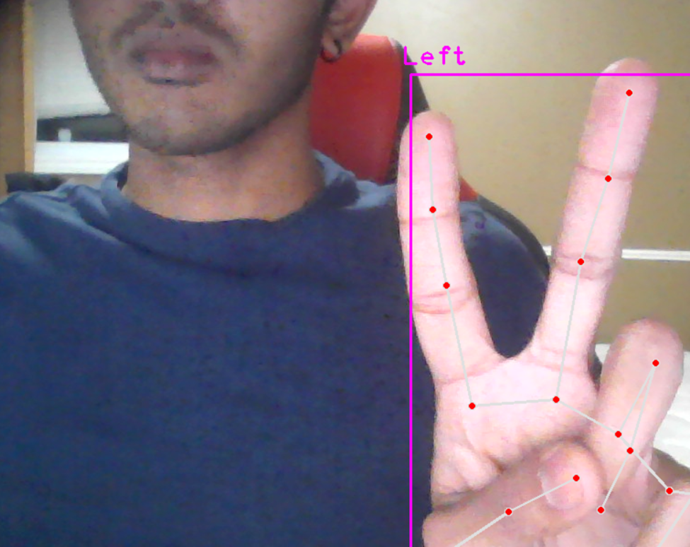
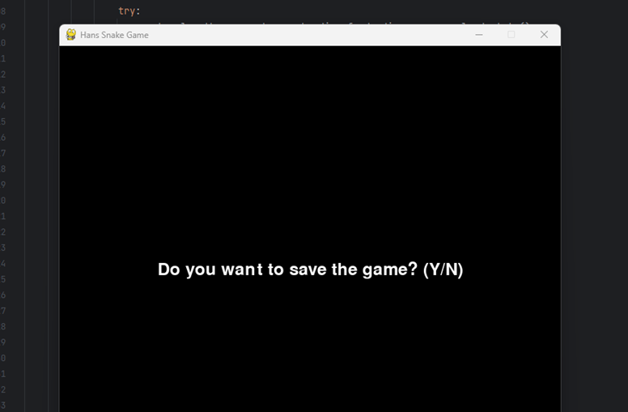
Testing
Setting up the gesture
Save/load games
Resume playing
When you run the program, a pop up will appear and ask you to hold a Gesture for authentication after you select a player profile
Each time you reach a score that is a multiple of 10, the program will ask you if you want to save your current game state.
If the verification gesture matches your gesture set at the beginning, the game resumes where you last saved it as soon as you press w, a, s or d to control the snake.

Slide 8
Observations
Shortcomings:
The game has no ending goal. (No target score to win)
The game closes if the gestures do not match when you try to load the game.
Advantages:
Save/load mechanism allows users to continue their game from the last saved state.
The snake game provides a classic gaming experience and everybody knows how to play the game.
Code can be modified to accept two handed gestures.
Disadvantages:
The gesture-based authentication process has a fixed time limit (5 seconds), which might be challenging for users.
The program take a bit of time to run as can be improved to increase efficiency

Slide 9
Thank you for your time!
By Emerit Beemul

